Slide 1
Probabilistic Assignments
INFO 4220 – Networks II: Market Design
Adapted from Haeringer Ch.12

Slide 2
Probabilistic Assignment
The assignments we have been studying are deterministic
  Objects are assigned to specific individuals
  Each time we repeat the algorithm we get the same result (if we don’t change anything else)
There is often some randomness in problems
  Two individuals are equally ranked and we need to introduce randomness to break ties
  In the serial dictatorship we said that the order of individuals was random. Although randomness is not required (it could be any order)

Slide 3
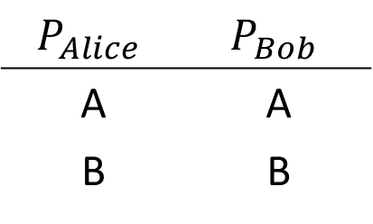
Example
$$P_{Alice}$$ | $$P_{Bob}$$
A | A
B | B
To whom should we assign object A?
    Assignment 1: Alice – A, Bob – B
    Assignment 2: Alice – B, Bob – A
We need to choose one or the other. If we use a deterministic assignment, an individual will be always favored
A random assignment can make allocation fair:
  50% chance we choose Assignment 1
  50% chance we choose Assignment 2

Slide 4
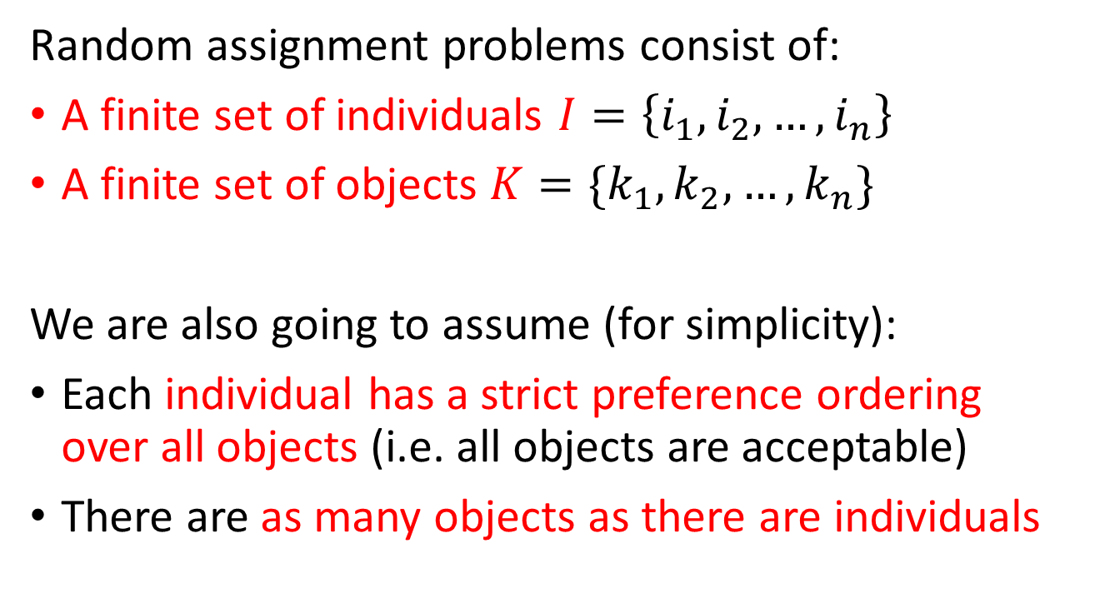
Random Assignment
Random assignment problems consist of:
A finite set of individuals $I=\left\{i_{1},i_{2},…,i_{n}\right\}$
A finite set of objects $K=\{k_{1},k_{2},…,k_{n}\}$
We are also going to assume (for simplicity):
Each individual has a strict preference ordering over all objects (i.e. all objects are acceptable)
There are as many objects as there are individuals

Slide 5
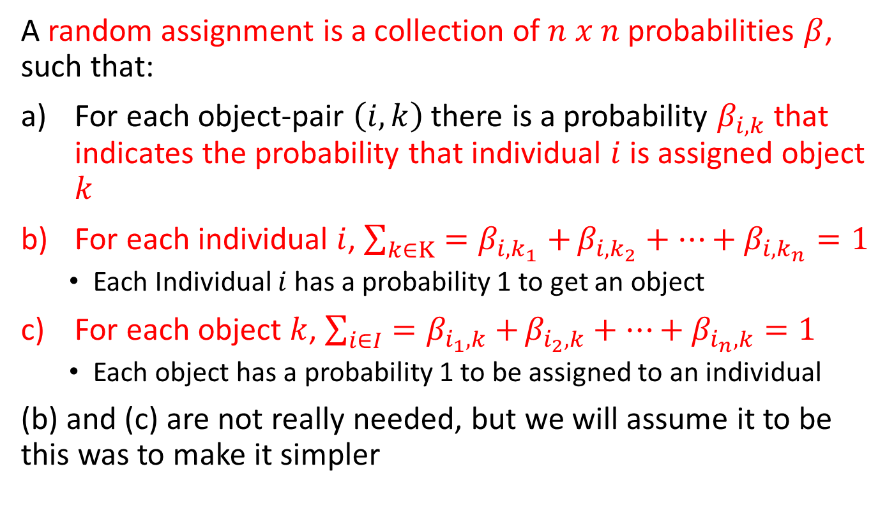
Random Assignment
A random assignment is a collection of $n x n$probabilities $β$, such that:
For each object-pair $\left(i,k\right)$ there is a probability $β_{i,k}$ that indicates the probability that individual $i$ is assigned object $k$
For each individual $i$, $\sum_{k∈K}{=β_{i,k_{1}}+}β_{i,k_{2}}+…+β_{i,k_{n}}=1$
  Each Individual $i$ has a probability 1 to get an object
For each object $k$, $\sum_{i∈I}{=β_{i_{1},k}+}β_{i_{2},k}+…+β_{i_{n},k}=1$
  Each object has a probability 1 to be assigned to an individual
(b) and (c) are not really needed, but we will assume it to be this was to make it simpler

Slide 6
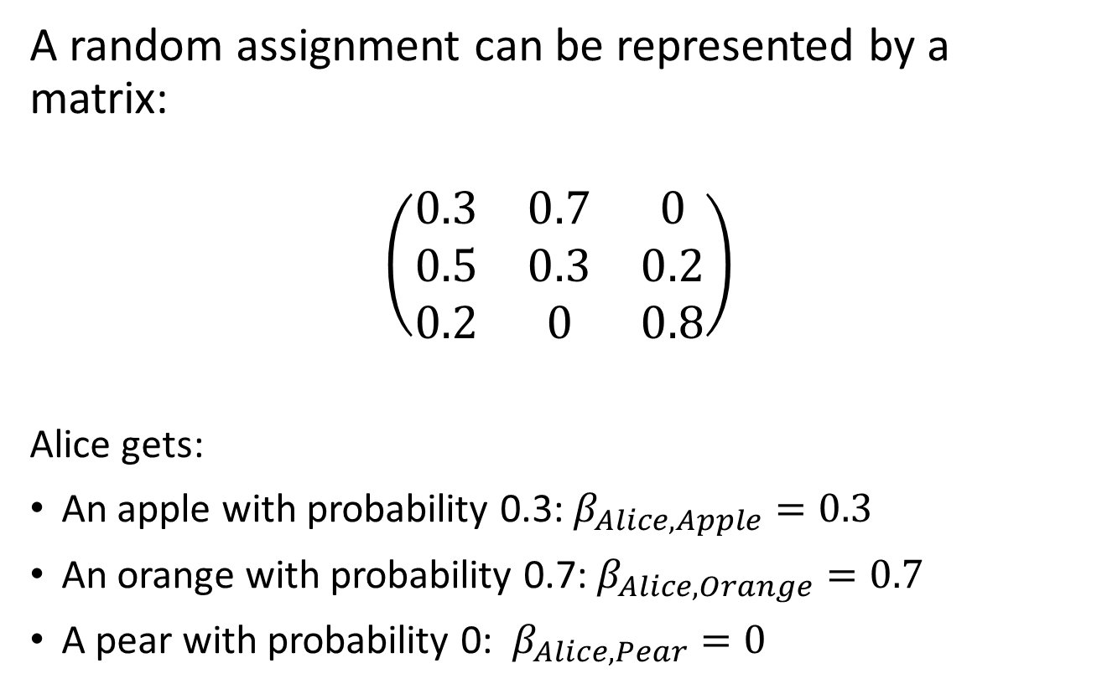
Example
A random assignment can be represented by a matrix:
$$\left(\begin{matrix}0.3 & 0.7 & 0 \\ 0.5 & 0.3 & 0.2 \\ 0.2 & 0 & 0.8\end{matrix}\right)$$
Alice gets:
An apple with probability 0.3: $β_{Alice,Apple}=0.3$
An orange with probability 0.7: $β_{Alice,Orange}=0.7$
A pear with probability 0: $β_{Alice,Pear}=0$
Apple
Orange
Pear
Alice
Bob
Carol

Slide 7
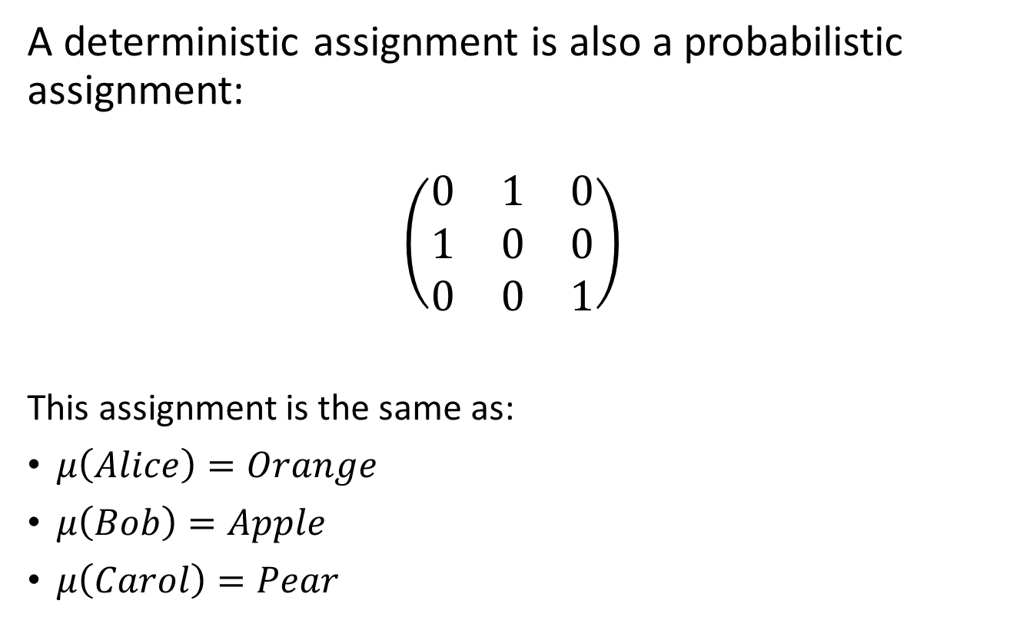
Example
A deterministic assignment is also a probabilistic assignment:
$$\left(\begin{matrix}0 & 1 & 0 \\ 1 & 0 & 0 \\ 0 & 0 & 1\end{matrix}\right)$$
This assignment is the same as:
$μ\left(Alice\right)=Orange$
$μ\left(Bob\right)=Apple$
$μ\left(Carol\right)=Pear$
Apple
Orange
Pear
Alice
Bob
Carol

Slide 8
Birkhoff-von Neumann theorem
A random assignment assigns to each individual-object pair a probability
In the way we describe the probabilities, it is implicit that they are independent. Thus, two individuals could get the same object at the same time?
How do we ensure that no two individuals eventually end up with the same object? (which cannot happen)
  There are two ways to describe a random assignment, and they are equivalent

Slide 9
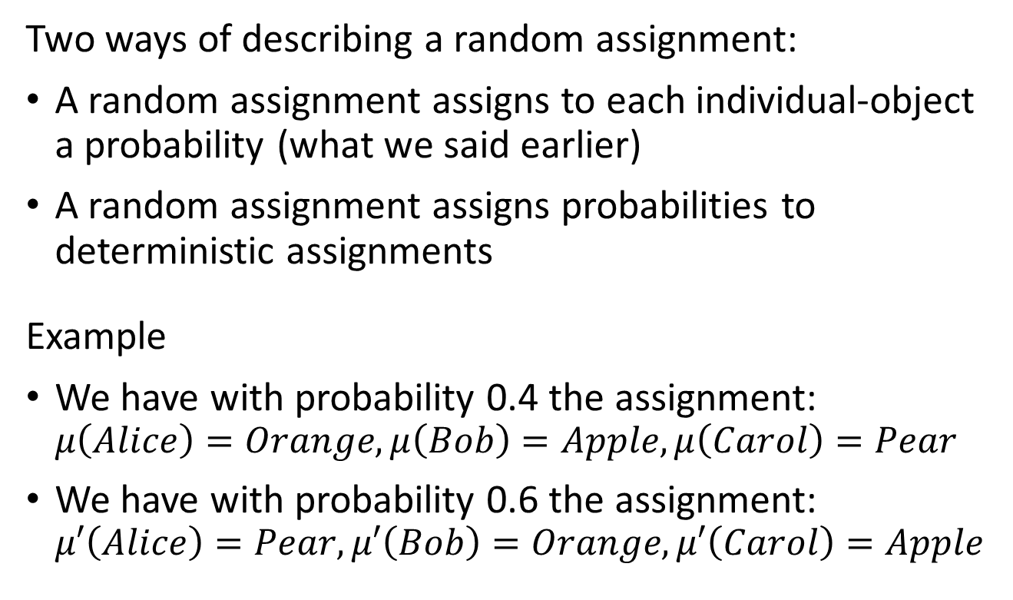
Birkhoff-von Neumann theorem
Two ways of describing a random assignment:
A random assignment assigns to each individual-object a probability (what we said earlier)
A random assignment assigns probabilities to deterministic assignments
Example
We have with probability 0.4 the assignment: $μ\left(Alice\right)=Orange, μ\left(Bob\right)=Apple, μ\left(Carol\right)=Pear$
We have with probability 0.6 the assignment: $μ′\left(Alice\right)=Pear, μ′\left(Bob\right)=Orange, μ′\left(Carol\right)=Apple$

Slide 10
Birkhoff-von Neumann theorem
Theorem (Birkhoff-von Neumann):
Any random assignment can be decomposed into a lottery over deterministic assignments

Slide 11
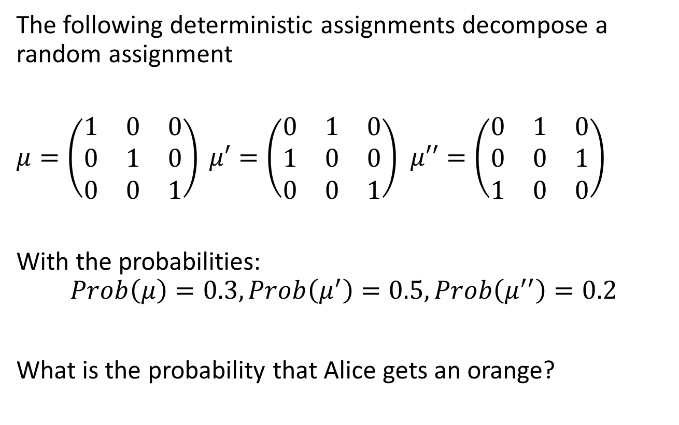
PollEV Question
The following deterministic assignments decompose a random assignment
$μ=\left(\begin{matrix}1 & 0 & 0 \\ 0 & 1 & 0 \\ 0 & 0 & 1\end{matrix}\right) μ′=\left(\begin{matrix}0 & 1 & 0 \\ 1 & 0 & 0 \\ 0 & 0 & 1\end{matrix}\right)$ $μ′′=\left(\begin{matrix}0 & 1 & 0 \\ 0 & 0 & 1 \\ 1 & 0 & 0\end{matrix}\right)$
With the probabilities:
$$Prob\left(μ\right)=0.3, Prob\left(μ^{′}\right)=0.5, Prob\left(μ^{′′}\right)=0.2$$
What is the probability that Alice gets an orange?
Apple
Orange
Pear
Alice
Bob
Carol

Slide 12
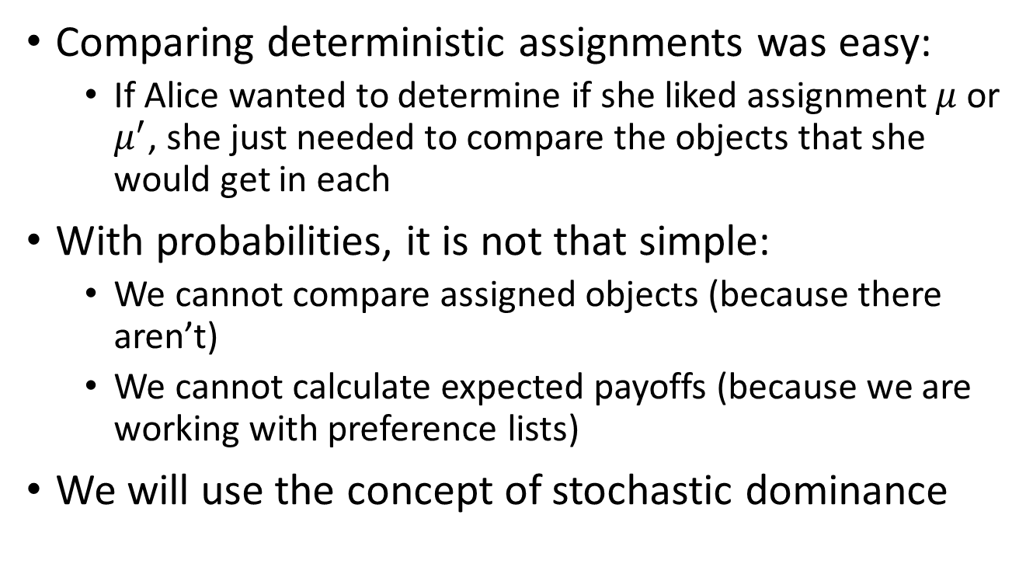
Evaluating Random Assignments
Comparing deterministic assignments was easy:
  If Alice wanted to determine if she liked assignment $μ$ or $μ^{′}$, she just needed to compare the objects that she would get in each
With probabilities, it is not that simple:
  We cannot compare assigned objects (because there aren’t)
  We cannot calculate expected payoffs (because we are working with preference lists)
We will use the concept of stochastic dominance

Slide 13
Harmless Definition of Stochastic Dominance
To compare vectors of probabilities we proceed in the following way:
Compare the probabilities of getting the most preferred object
Compare the probabilities of getting the two most preferred objects
Compare the probabilities of getting the three most preferred objects
And so on…
If at every step one vector is better than the other, we say that it stochastically dominates the other

Slide 14
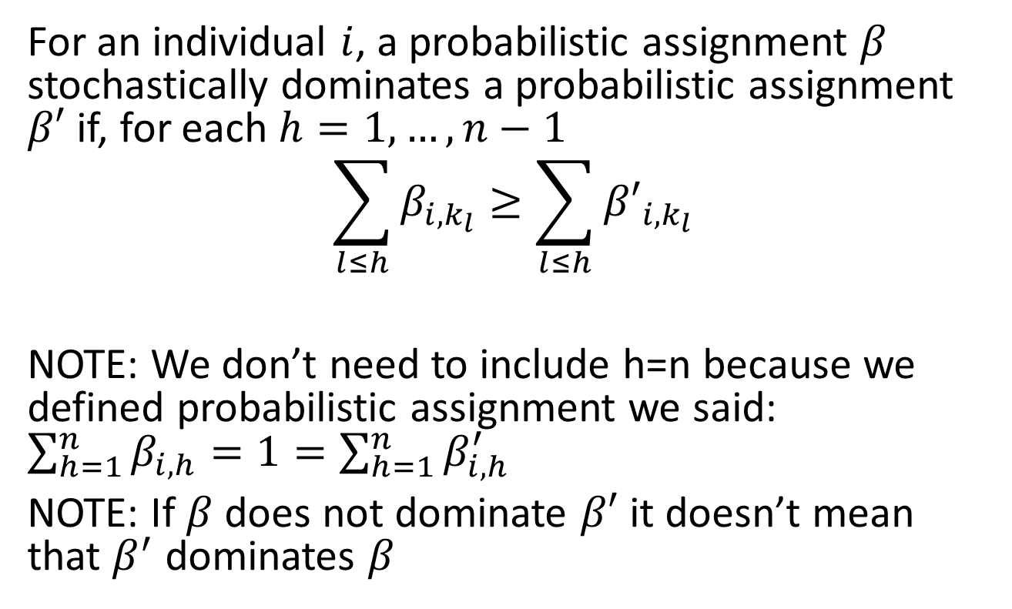
Definition of Stochastic Dominance
For an individual $i$, a probabilistic assignment $β$ stochastically dominates a probabilistic assignment $β′$ if, for each $h=1,…,n−1$
$$\sum_{l≤h}{β_{i,k_{l}}≥\sum_{l≤h}{{β′}_{i,k_{l}}}}$$
NOTE: We don’t need to include h=n because we defined probabilistic assignment we said: $\sum_{h=1}^{n}{β_{i,h}=1=\sum_{h=1}^{n}{β_{i,h}^{′}} }$
NOTE: If $β$ does not dominate $β′$ it doesn’t mean that $β^{′}$ dominates $β$

Slide 15
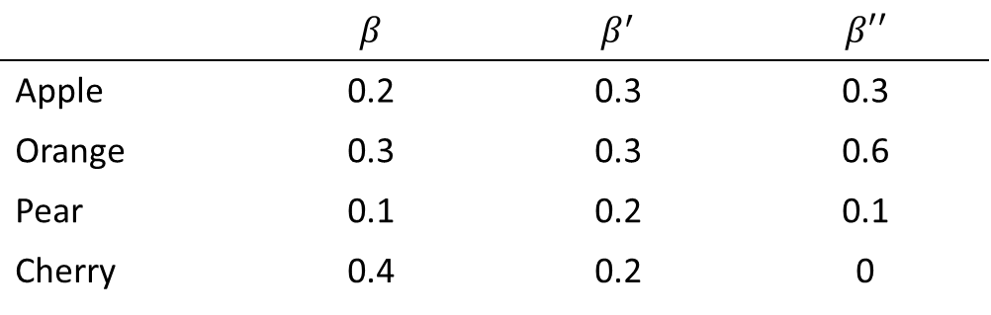
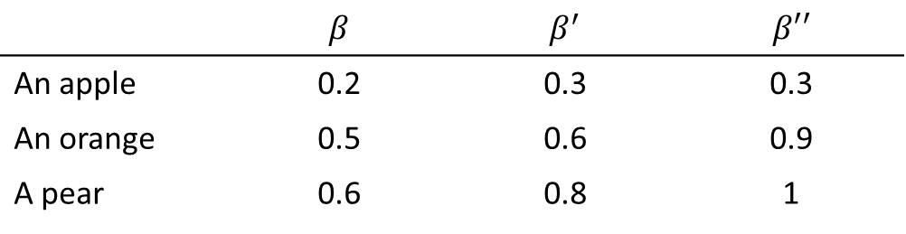
Example
Suppose Alice’s preferences are: Apple, orange, pear, cherry
 | $$β$$ | $$β^{′}$$ | $$β′′$$
Apple | 0.2 | 0.3 | 0.3
Orange | 0.3 | 0.3 | 0.6
Pear | 0.1 | 0.2 | 0.1
Cherry | 0.4 | 0.2 | 0
Thus, the probabilities of getting something as good as (for Alice):
 | $$β$$ | $$β^{′}$$ | $$β′′$$
An apple | 0.2 | 0.3 | 0.3
An orange | 0.5 | 0.6 | 0.9
A pear | 0.6 | 0.8 | 1

Slide 16
PollEV
Suppose Alice’s preferences are: Apple, orange, pear, cherry
 | $$β$$ | $$β^{′}$$ | $$β′′$$
Apple | 0.2 | 0.3 | 0.3
Orange | 0.3 | 0.3 | 0.6
Pear | 0.1 | 0.2 | 0.1
Cherry | 0.4 | 0.2 | 0
Thus, the probabilities of getting something as good as:
 | $$β$$ | $$β^{′}$$ | $$β′′$$
An apple | 0.2 | 0.3 | 0.3
An orange | 0.5 | 0.6 | 0.9
A pear | 0.6 | 0.8 | 1
Which of this assignments stochastically dominates the others (for Alice)?

Slide 17
Random Serial Dictatorship
Obvious problem with serial dictatorship: Individuals high in the queue are favored
A random serial dictatorship brings fairness
  Assign the order randomly in first step
  Now everyone has the same chance of being at any position
Something surprising happens when we add randomness to the serial dictatorship
It becomes equivalent to the TTC algorithm (after adding randomization to the TTC)

Slide 18
TTC with Random Endowments
We have seen two versions of the TTC:
  With public endowments
  With private endowments
Trick to introduce randomization
  Take the TTC with public endowments and make the endowments random
  Then run the TTC algorithm

Slide 19
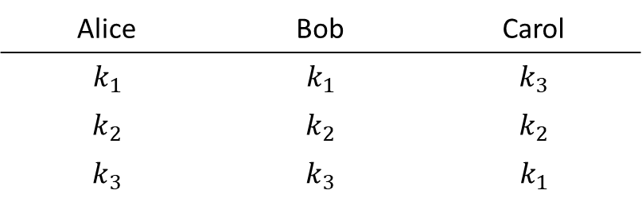
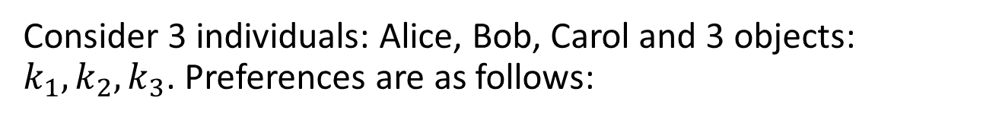
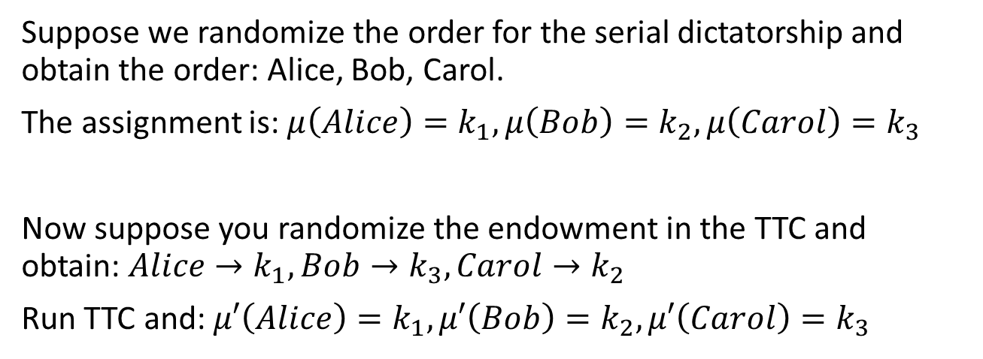
Example
Consider 3 individuals: Alice, Bob, Carol and 3 objects: $k_{1},k_{2},k_{3}$. Preferences are as follows:
Alice | Bob | Carol
$$k_{1}$$ | $$k_{1}$$ | $$k_{3}$$
$$k_{2}$$ | $$k_{2}$$ | $$k_{2}$$
$$k_{3}$$ | $$k_{3}$$ | $$k_{1}$$
Suppose we randomize the order for the serial dictatorship and obtain the order: Alice, Bob, Carol.
The assignment is: $μ\left(Alice\right)=k_{1}, μ\left(Bob\right)=k_{2}, μ\left(Carol\right)=k_{3}$
Now suppose you randomize the endowment in the TTC and obtain: $Alice→k_{1},Bob→k_{3},Carol→k_{2}$
Run TTC and: $μ′\left(Alice\right)=k_{1}, μ′\left(Bob\right)=k_{2}, μ′\left(Carol\right)=k_{3}$

Slide 20
Example (cont.)
We picked a random order for the serial dictatorship and a random assignment for the TTC and obtained the same assignments
This is not always going to happen (that using the same order in RSD and TTC you get the same result)
But when we consider all possible random orders in the serial dictatorship, and all possible initial endowments in TTC -> Resulting random assignment will be the same

Slide 21
Theorem (Abdulkadiroğlu and Sönmez)
For any assignment problem with the same number of individuals and objects:
The random assignments generated by the Random Serial Dictatorship algorithm are the same (with the same probabilities) as the random assignments generated by the Top Trading Cycle algorithm with random endowments.

Slide 22
Ex-ante vs. Ex-post
When introducing randomness in an assignment, there are two ways to evaluate the assignments:
Ex-Ante:
We look at the assignments that can be obtained before the random draw happens
We use stochastic dominance to compare
Ex-Post:
We look at the assignments that are obtained after the random draw happens
We use the actual assignments to compare

Slide 23
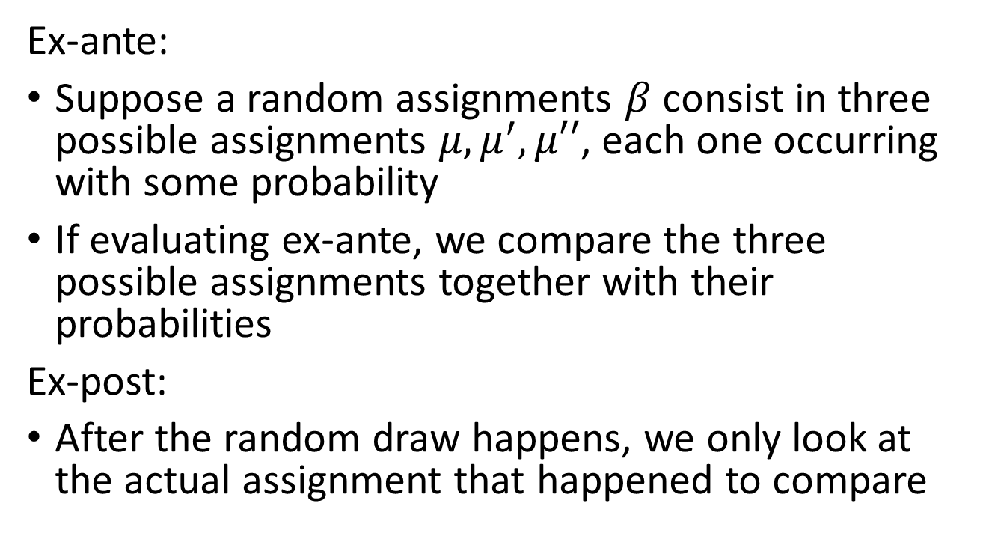
Ex-ante vs. Ex-post
Ex-ante:
Suppose a random assignments $β$ consist in three possible assignments $μ,μ^{′},μ′′$, each one occurring with some probability
If evaluating ex-ante, we compare the three possible assignments together with their probabilities
Ex-post:
After the random draw happens, we only look at the actual assignment that happened to compare

Slide 24
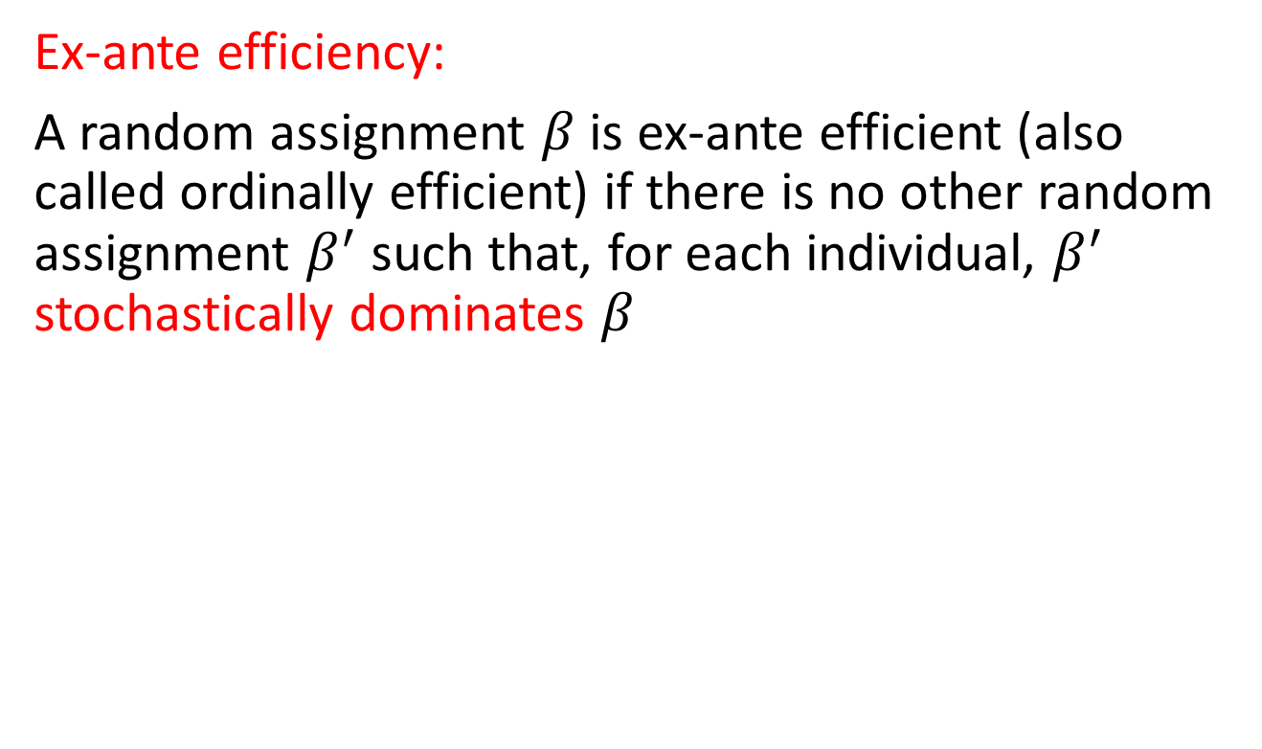
Efficiency
Ex-ante efficiency:
A random assignment $β$ is ex-ante efficient (also called ordinally efficient) if there is no other random assignment $β^{′}$ such that, for each individual, $β^{′}$ stochastically dominates $β$

Slide 25
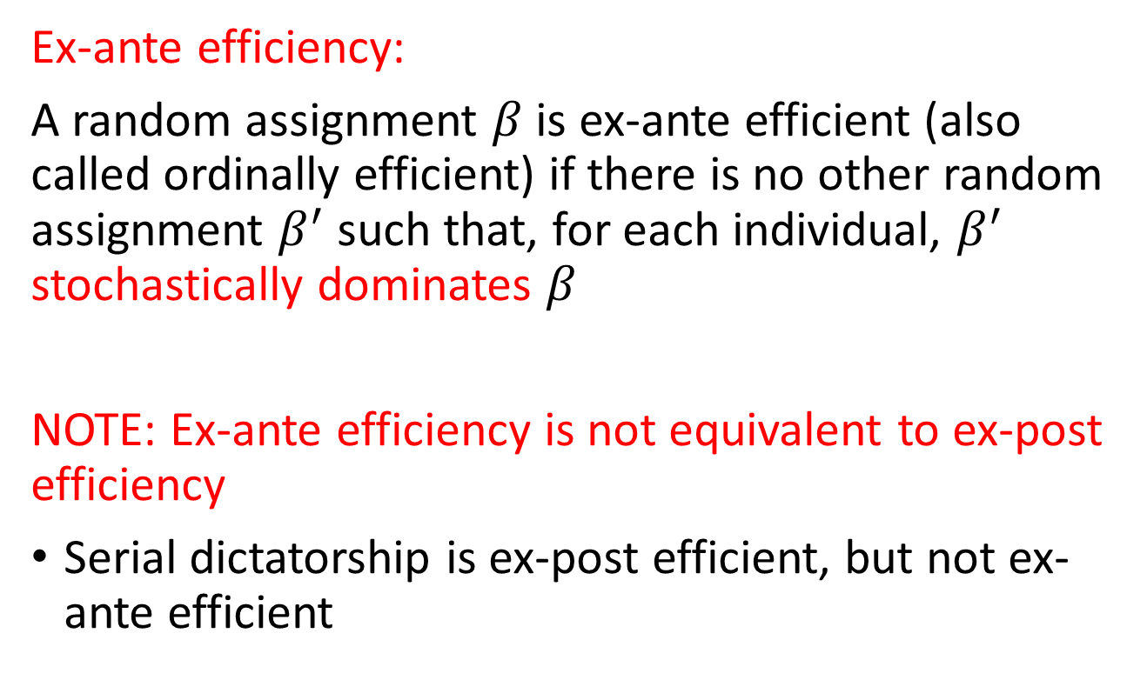
Efficiency
Ex-ante efficiency:
A random assignment $β$ is ex-ante efficient (also called ordinally efficient) if there is no other random assignment $β^{′}$ such that, for each individual, $β^{′}$ stochastically dominates $β$
NOTE: Ex-ante efficiency is not equivalent to ex-post efficiency
Serial dictatorship is ex-post efficient, but not ex-ante efficient

Slide 26
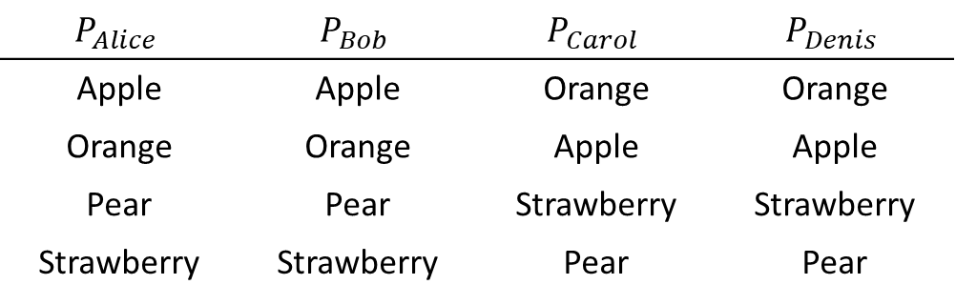
Example
If we randomize something that is ex-post efficient (i.e. RSD), will we obtain an ex-ante efficient outcome?
Not necessarily.
Consider 4 individuals and 4 objects
$$P_{Alice}$$ | $$P_{Bob}$$ | $$P_{Carol}$$ | $$P_{Denis}$$
Apple | Apple | Orange | Orange
Orange | Orange | Apple | Apple
Pear | Pear | Strawberry | Strawberry
Strawberry | Strawberry | Pear | Pear
There are 4!=24 possible orders for the serial dictatorship

Slide 27
Example
In the 24 possible orderings:
Alice is first in 6 cases: She gets the apple
Alice is second in 6 cases:
  Two times when Bob is first: She gets Orange
  Two times when Carol is first: She gets the Apple
  Two times when Denies is first: She gets the Apple
Alice is third in 6 cases:
  If Bob is first or second, she cannot get the apple. Also, if the order is Carol-Denis or Denis-Carol, she doesn’t get the apple either.
Alice is last in 6 cases: And she never gets the apple

Slide 28
Example
Alice gets the apple in 10 of 24 cases (Probability 5/12)
Bob has the same preferences as Alice, so we can repeat the analysis and obtain the same probability
We can do the same for Carol and Denis, and their probability is 1/12
And we can re-do everything for each object

Slide 29
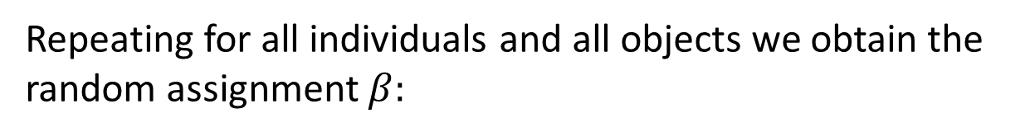
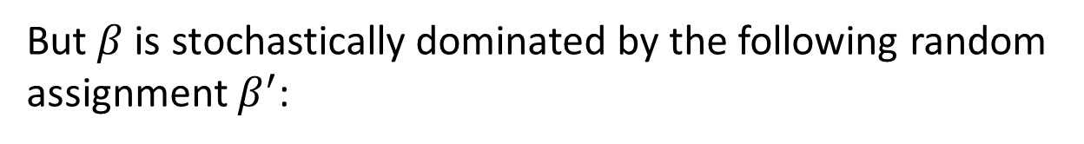
Example
Repeating for all individuals and all objects we obtain the random assignment $β:$
 | Apple | Orange | Pear | Strawberry
Alice | 5/12 | 1/12 | 5/12 | 1/12
Bob | 5/12 | 1/12 | 5/12 | 1/12
Carol | 1/12 | 5/12 | 1/12 | 5/12
Denis | 1/12 | 5/12 | 1/12 | 5/12
(
)
But $β$ is stochastically dominated by the following random assignment $β^{′}$:
 | Apple | Orange | Pear | Strawberry
Alice | 1/2 | 0 | 1/2 | 0
Bob | 1/2 | 0 | 1/2 | 0
Carol | 0 | 1/2 | 0 | 1/2
Denis | 0 | 1/2 | 0 | 1/2
(
)

Slide 30
Eating Algorithms
Used to obtain ex-ante efficient assignments
Imagine that individuals “eat” the objects, and the share of each object they ate give the probabilities
Probabilistic Serial Algorithm:
  When the algorithm starts, each individual starts eating her most preferred object (at a give eating speed)
  When the object an individual is eating is entirely eaten then:
    The fraction of the object that has been eaten will be the probability that the individual is assigned that object
    The individual starts eating the most preferred object among the objects that are not entirely eaten yet

Slide 31
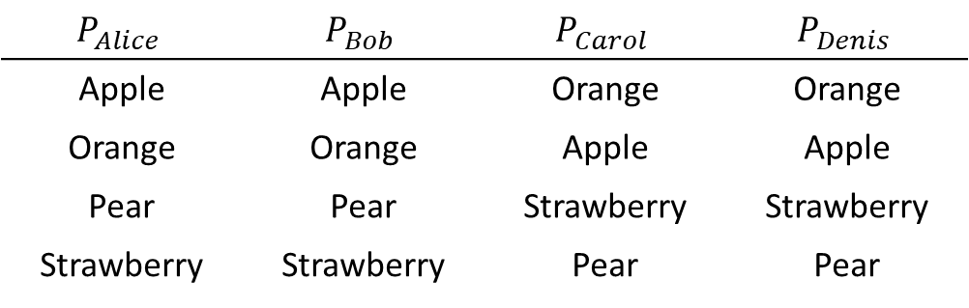
Example
$$P_{Alice}$$ | $$P_{Bob}$$ | $$P_{Carol}$$ | $$P_{Denis}$$
Apple | Apple | Orange | Orange
Orange | Orange | Apple | Apple
Pear | Pear | Strawberry | Strawberry
Strawberry | Strawberry | Pear | Pear
Let’s consider the same case we had
At time zero:
  Alice and Bob start eating the apple
  Carol and Denis start eating the orange
After some time:
  Alice and Bob finish the apple, they each ate ½
  Carol and Denis finish the orange, the each ate ½

Slide 32
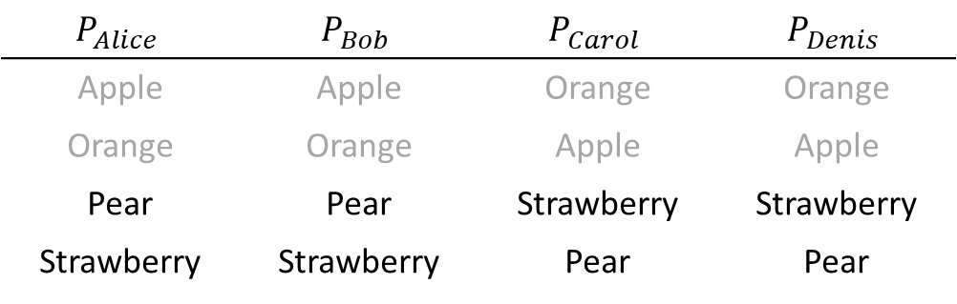
Example
$$P_{Alice}$$ | $$P_{Bob}$$ | $$P_{Carol}$$ | $$P_{Denis}$$
Apple | Apple | Orange | Orange
Orange | Orange | Apple | Apple
Pear | Pear | Strawberry | Strawberry
Strawberry | Strawberry | Pear | Pear
Next:
  Alice and Bob would like to continue with the orange, but that is gone, so they both start eating the pear
  Carol and Denis would like to continue with the apple, but that is also gone, they continue with strawberry
After some time:
  Alice and Bob finish the pear, each ate ½
  Carol and Denis finish the strawberry, each ate ½

Slide 33
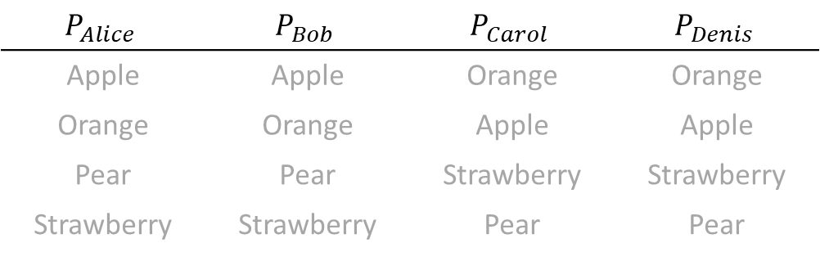
Example
$$P_{Alice}$$ | $$P_{Bob}$$ | $$P_{Carol}$$ | $$P_{Denis}$$
Apple | Apple | Orange | Orange
Orange | Orange | Apple | Apple
Pear | Pear | Strawberry | Strawberry
Strawberry | Strawberry | Pear | Pear
Finally:
  Alice ate ½ apple and ½ pear (same for Bob)
  Carol ate ½ orange and ½ strawberry (same for Denis)
 | Apple | Orange | Pear | Strawberry
Alice | 1/2 | 0 | 1/2 | 0
Bob | 1/2 | 0 | 1/2 | 0
Carol | 0 | 1/2 | 0 | 1/2
Denis | 0 | 1/2 | 0 | 1/2
(
)

Slide 34
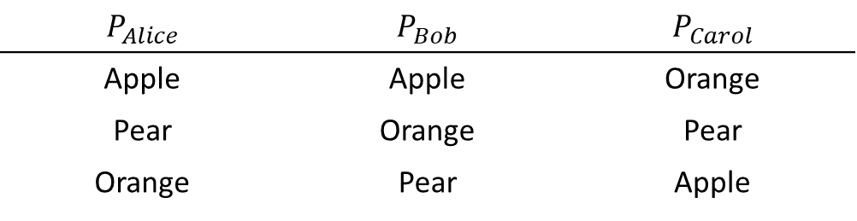
PollEV Question
$$P_{Alice}$$ | $$P_{Bob}$$ | $$P_{Carol}$$
Apple | Apple | Orange
Pear | Orange | Pear
Orange | Pear | Apple
Apply the probabilistic serial algorithm
Probability of Bob getting the Orange: A) 0 B)¼ C)½ D)¾ E)1

Slide 35
Theorem (Bogomolnaia and Moulin)
For any problem and for any eating speed functions, the random assignments calculated with the probabilistic serial algorithm is ex-ante efficient
Conversely, for any ex-ante efficient random assignment there exist an eating speed function for each individual such that the Probabilistic Serial algorithm yields this random assignment

Slide 36
Theorem (Bogomolnaia and Moulin)
Is then the Probabilistic Serial algorithm the “right” algorithm?
NO. Because there is a conflict between ex-ante efficiency and strategyproofness
Equal Treatment of equals: Two individuals with the same preferences should obtain the same probabilities
Theorem:
Whenever there are at least 4 individuals, there is no random assignment mechanism that is always ex-ante efficient, strategyproof, and that satisfies the equal treatment of equals property

Slide 37
Announcements
We are grading the prelim and PS2 next week. We will try hard to get results back to you before PS3 is released
PS3 will be released March-14
If you have a regrade request for PS1, send them ASAP using the form
  You will not receive an answer immediately, we process them all together once the period to submit requests ends (Next week)
I will ask you to complete a short survey to know how the course is going (link in Ed)

Slide 38
Take Away
We talked about probabilistic (random) assignments
Randomness is often introduced to assignment mechanisms to address fairness issues
To compare two probabilistic assignments we use stochastic dominance
Random serial dictatorship is a common and simple probabilistic assignment mechanism. It is equivalent to the Top Trading Cycle with random endowments

Slide 39
Take Away
With probabilistic assignments we can evaluate efficiency ex-ante or ex-post (remember the game)
Ex-ante efficiency and ex-post efficiency are not equivalent
Random serial dictatorship is ex-post efficient, but it is not (always) ex-ante efficient
Any ex-ante efficiency can be obtained using an eating algorithm using an appropriate eating function speed
With 4 or more individuals, ex-ante efficiency, strategyproofness, and equal treatment of equals are incompatible

